Slide 1
DTC Onboarding steps
Week 1

Slide 2




Agenda
Day 1
Day 2 and 3 steps
Day 4 and 5 steps
DTC Digital Hire Program
----------------------
Backup slides
Pictograms Hints:
Trainer led session/Workshop
Face to Face Meeting
Self-Paced training / Virtual

Slide 3
Steps of onboarding Day 1
Applicable for all roles, profiles and grades in DTC
Pre-Hiring
Post-Hiring
Duration varies
Day 1
Day 1
Day 1
Day 1
Short F to F session
HM to check if there are any outstanding tasks/issues
Recruiting
Candidate accepts offer letter
Meet your Onboarding Buddy
Get Ready and Setup PC
Room: Pirin
Lunch
Setup PC
DTC Onboarding Checklist App
Tasks are divided between Hiring Managers and Recruiters:
Recruiter – Pre-screening, QI form and F to F interview scheduling
HM – Conduct interview and submit request for hiring/reject the candidate
DTC Representative
Meet the newcomers on the reception
Seat allocation and assets
Floor Office Tour (incl. mailroom, print room)
DTC Representative
Provide PC setup guide to the newcomer and
Newcomer’s tasks:
- Setup your PC and request all needed accesses
Newcomer’s tasks
Complete PC setup
Review and check your Onboarding activities:
Make a profile in DXC’s Onboarding App and start working with your checklist (profile setup guide received via email)

Slide 4
Steps of onboarding Day 2 and 3
Applicable for all roles, profiles and grades in DTC
Post-Hiring
Day 2
Day 2
Day 2
Day 3
You will receive additional invitation
Coffee and Mail check
DTC Digital Hire Program
Lunch
DTC Onboarding Checklist App
DTC Digital Hire Program
Lunch
Site Induction Training
Room: TBD
Newcomer’s tasks
Follow the Newcomer’s guide (received via email)
Start your DTC Digital Hire self-paced trainings (more info – slide 4)
Newcomer’s tasks
Follow the Newcomer’s guide (received via email)
Start your DTC Digital Hire self-paced trainings (more info – slide 4)
Rodrigo Olguin will lead a F2F Site Induction Training session
Review and check your Onboarding activities:
- Follow the tasks in the Onboarding app

Slide 5
Steps of onboarding Day 4 and 5
Applicable for all roles, profiles and grades in DTC
Post-Hiring
Day 4
Day 4
You will receive additional invitation - If you are not invited to F2F NEO within 2 weeks, please take the virtual NEO class in SABA
Day 5
DTC Digital Hire Program
Lunch
DTC Digital Hire Program
Lunch
DTC Onboarding Checklist App
NEO Training
Room: TBD
Newcomer’s tasks
Follow the Newcomer’s guide (received via email)
Continue the DTC Digital Hire self-paced trainings (more info – slide 4)
Ralitsa Petrova will lead a F2F New Employee Orientation session
Review and check your Onboarding activities:
- Follow the tasks in the Onboarding app

Slide 6

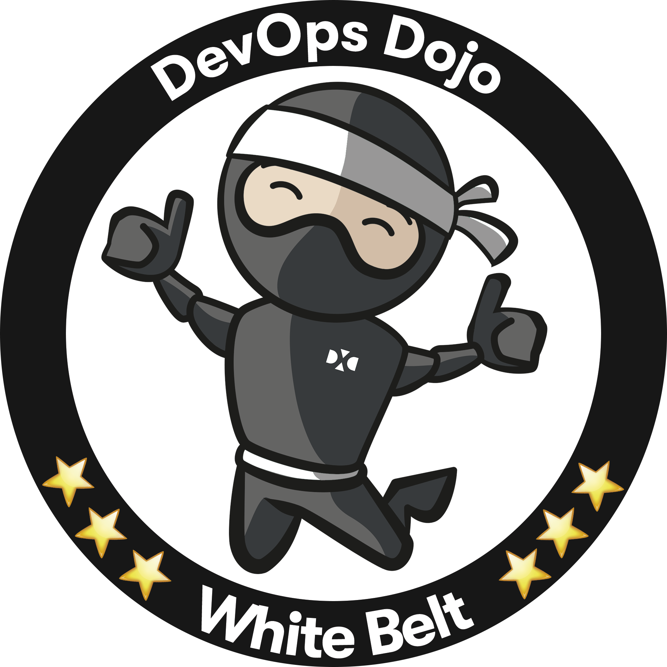


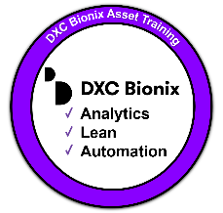
DTC Digital Hire Program
DTC Digital Hire Program
Delivery Type: Self-paced with mentoring from on-site experts (Scrum Masters, DevOps leaders, etc.) | Configuration: 36-hour program consisting of Saba Cloud courses & curricula for reporting | Delivery Responsibility: Accredited facilitators in each DTC (See DXC Training Facilitator Accreditation Process)
DTC-owned program
Audience: All external hires and redeploy employees
Completion Requirements: Complete all training, then update Skills Profile in DXC University (Learn more about Skills Management or access the Employee Guide)
Program Components
Digital Foundation (curriculum 00041943). Completing this two-hour self-paced curriculum will award the Digital Foundation learning badge and provided a foundation of digital awareness at DXC.
Thinking Digital
Understanding Digital (including Spartans White Belt 3.0 Digital Transformation)
Solving Digital
Building Digital (DXC Bionix and Agile)
Embracing Digital (Knowledge check)
Being an Effective Team Member (course 00006746).
Completing this 30-minute self-paced course provides strategies and techniques to help you become a more effective and valued member of your team so that you can make a significant contribution. (Adopt a positive mindset, acknowledge differences constructively, show respect for others, be proactive and work collaboratively)
DXC DevOps Dojo White Belt (curriculum 00019783). Completing this two-hour self-paced curriculum will award the DevOps Dojo White Belt learning badge and provides an overview of DevOps and its benefits.
Curriculum Introduction by Chris Swan, VP CTO Global Delivery Organization
DevOps Concepts to understand DevOps benefits and metrics
Katacoda Git and GitHub to make your first Pull request
Katacoda Ansible to run your first Playbook
Katacoda Jenkins to build your first Continuous Integration/Continuous Delivery (CI/CD) pipeline
DXC Bionix Asset Training (curriculum 00042727). Completing this two-hour self-paced curriculum will award the DXC Bionix™ learning badge and provides awareness of DXC Bionix™ assets in order to drive their adoption and realize the benefits of the DXC Bionix™ Transformation Program.
DXC Bionix Introduction
DXC Bionix Levers Overview
ITO, Applications and BPS Automation Assets
Design Thinking Process (course 00036630). Completing this one-hour self-paced course provide a baseline understanding of Design Thinking – a human-centered approach to innovation that integrates the needs of the user, the possibilities of technology, and the requirements of business success to ensure that we address our customers’ most important concerns.
Platform DXC Awareness Training – OD&T (curriculum 00048495). Completing this 15-hour self-paced curriculum provides a baseline understanding of Platform DXC.
Product Lifecycle Management (PLM) concepts
Intelligence Pillar
Orchestration Pillar
Automation Pillar
Core
Agile Beginner (curriculum 00036294). Completing this 12.5-hour live virtual and self-paced curriculum provides a baseline understanding of Agile frameworks (Scrum & Kanban). (Refer to the open virtual instructor-led schedule to view available classes if not attending a site-specific class.)
Agile Practices Overview (CAT411E) (4 hours vILT – 2 hours x 2 days)
Kanban Overview (CAT419) (2 hours vILT)
Scrum in Practice Overview (CAT415) (5 hours vILT – 2.5 hours x 2 days)
Agile Online Resources (1.5 hours self-paced)
Product Development Approach Overview (course 00052460). Completing this one-hour training provides an overview of DXC’s Product Development Approach, a collaborative engagement framework that allows DXC and client teams to start delivering a solution within DXC’s DTCs. Participants will follow a business scenario through the five phases of DXC’s Product Development Approach.

Slide 7
Thank you.

Slide 8
Backup Slides

Slide 9
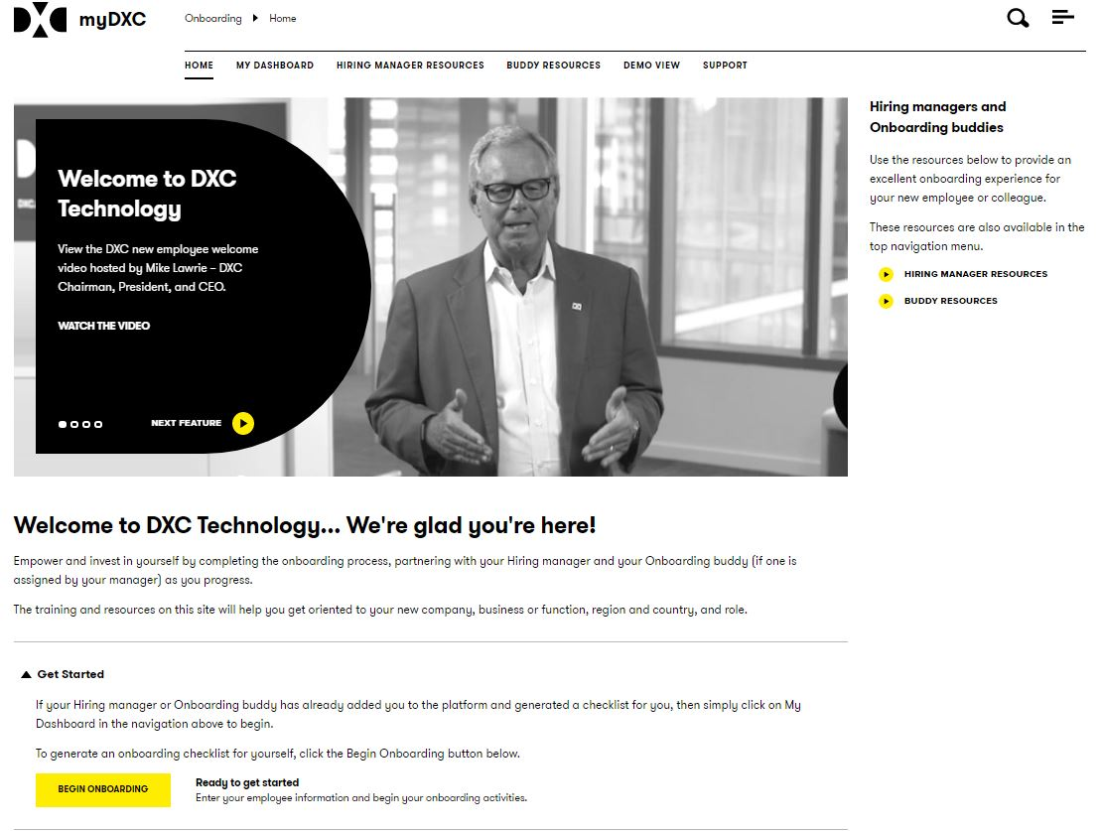
Global DXC Onboarding Web App
Global DXC Onboarding web app
The site will be used to track DXC’s Onboarding app checklist.
https://my.dxc.com/onboarding

Slide 10

DTC Vision and Goals
Our goal is to train all DTC members in a “New Wave” training
by mixing the following approaches:
Virtual Trainings
F to F open discussions
Instructor led workshops
Co-working / Shadowing
After the 90 days period we expect to have multi-skilled employees capable of working on complex Non-Standard projects. Starting with a business approach, using design thinking, product development, agile ways of working and DevOps solutions.
We would like to build a place, a way of working, a different culture!

